Slide 1
CSE CONSULTANCY SERVICES PLATFORM (CSE-CSP)
Major Project (Group – 15)
By :
Dilraj Singh (2104092)
Ekuspreet Singh (2104097)
Harsimran Singh (2104117)

Slide 2
CONTENTS
Introduction
Objectives
Justification of Need
User Flow
Technical Stack
Outcomes Expected

Slide 3


INTRODUCTION
CSE-CSP is a consultancy services platform created for the Department of Computer Science & Engineering at GNDEC. It provides students with opportunities for hands-on experience by connecting them with projects offered by alumni. This platform aims to enhance students' professional skills and build meaningful connections between students and alumni.

Slide 4
OBJECTIVES
To create a web platform that allows interaction amongst students, mentors and alumni for requesting and performing tasks.
To create an API in node in MVC architecture for seamless data transactions with clients and databases.
To integrate the project within the college’s administrative and technical framework.

Slide 5
JUSTIFICATION OF NEED
Students often lack practical experience in their field. CSE-CSP provides real-world projects to bridge this gap, enhancing their readiness for professional roles.
Alumni have valuable industry experience and can offer relevant projects that reflect current industry practices, helping students gain insights into the latest technologies and methodologies.
Hands-on experience with real projects significantly boosts students' employability by demonstrating their skills to potential employers and enhancing their resumes.
The platform fosters stronger connections between students and industry professionals, creating networking opportunities that can lead to mentorship, internships, and job placements.

Slide 6
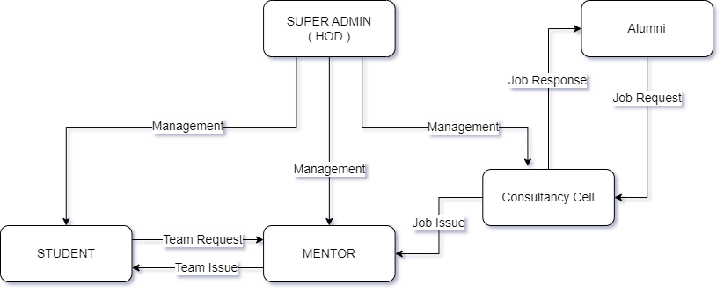
USER FLOW

Slide 7
TECHNICAL STACK
Node.js
Express.js
EJS
Tailwind CSS
Daisy UI
PostgreSQL

Slide 8
OUTCOMES EXPECTED
Alumni of our college will be able to post jobs on this platform very conveniently.
Students will be able to see the posted jobs and form their teams to complete the job.
Student’s team will be able to reach out to mentors for seeking the job opportunity. Otherwise, Mentors will be able to form team of students for the required specific task by alumni.
Mentors will be able to reach out to consultancy cell with the details of students who are ready to work for the required task.
Consultancy cell will be able to communicate with alumni directly.
Admin will be able to view and manage all the information about all the posted jobs.
This project will help students to build corporate connections with the outside world and build stronger student-alumni network.

Slide 9
Thank you

